Slide 1
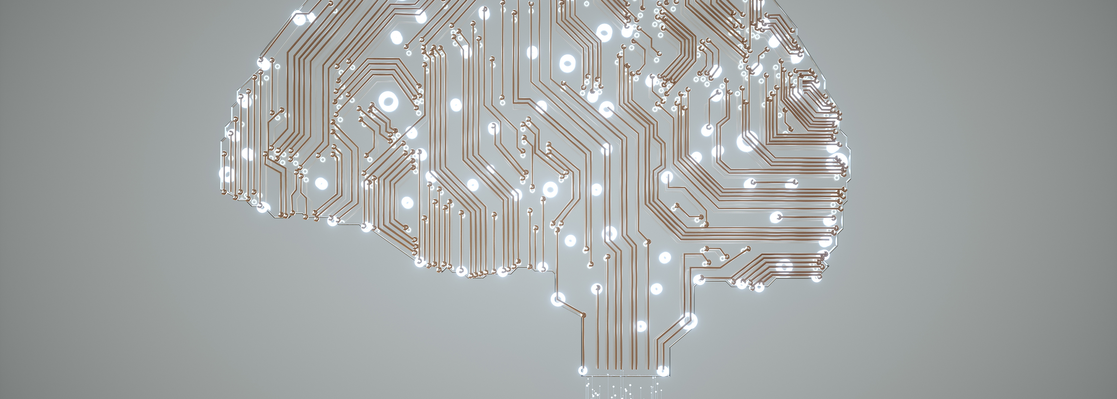
AI for Cognitive Neuroscience
Session 3
May 8, 2024

Slide 2
Outline
Introduction
Dataset overview
BIDS format
Loading data
Visualizing data
Making descriptive summary

Slide 3
Learning goals
Understand the basics of the BIDS format
Load a BIDS dataset
Visualize the data
Make descriptive summary of the data

Slide 4
Download the data
Get data from SurfDrive:
https://surfdrive.surf.nl/files/index.php/s/kluWxSX9lsuPVde
Materials -> Session3 -> eeg_matchingpennies

Slide 5
Paper discussion
(12-15 minutes): arrange in groups of 4-5 people to discuss per paper (3 minutes per paper):
3 things you learned
1 thing you want to know more about
Machine learning classifiers and fMRI: a tutorial overview.
A Review on Machine Learning for EEG Signal Processing in Bioengineering
How does artificial intelligence contribute to iEEG research?
Tutorial: Applying Machine Learning in Behavioral Research
(5 minutes) General discussion

Slide 6

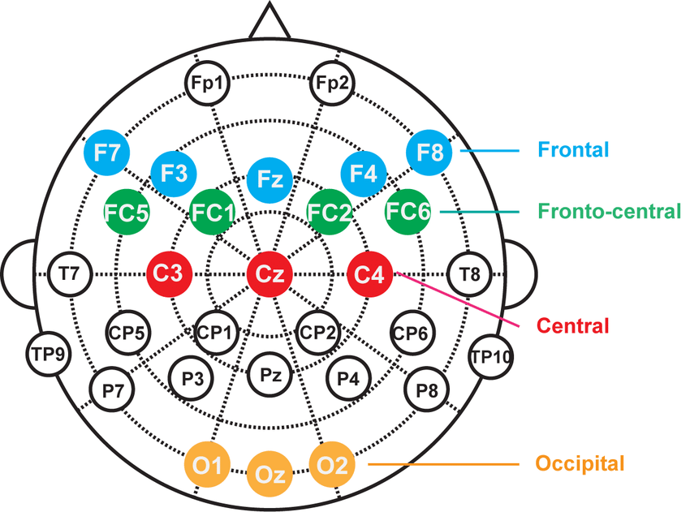

Data overview
Matching pennies dataset:
10 EEG channels
7 subjects
raising either their left or right hand
BIDS
Appelhoff, S., Sauer, D. & Gill, S. S. Matching Pennies: A Brain Computer Interface Implementation Dataset. Open Science Framework, https://doi.org/10.17605/OSF.IO/CJ2DR (2018).

Slide 7


Setup
Code to follow on Git: https://github.com/Immiora/ai-cog-neuro/tree/main/ai-cog-neuro/2024
Run on your local PC, if troubles: follow on colab: https://colab.research.google.com/github/Immiora/ai-cog-neuro/blob/main/ai-cog-neuro/2024/session3-data-load-viz/dataflow.ipynb

Slide 8
Setup
Create virtual environment:
conda –n ai_course python
conda activate ai_course
Launch Pycharm

Slide 9
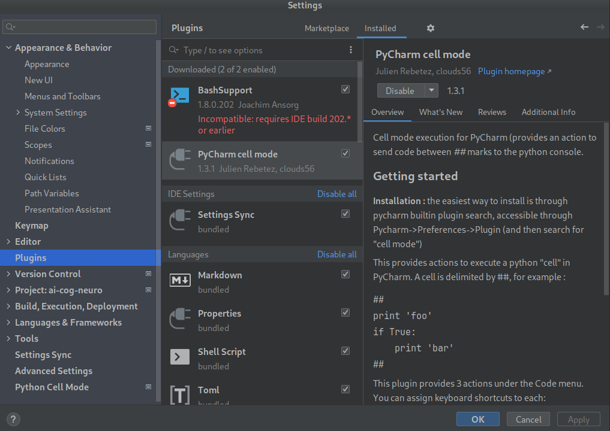
Pycharm cell mode

Slide 10
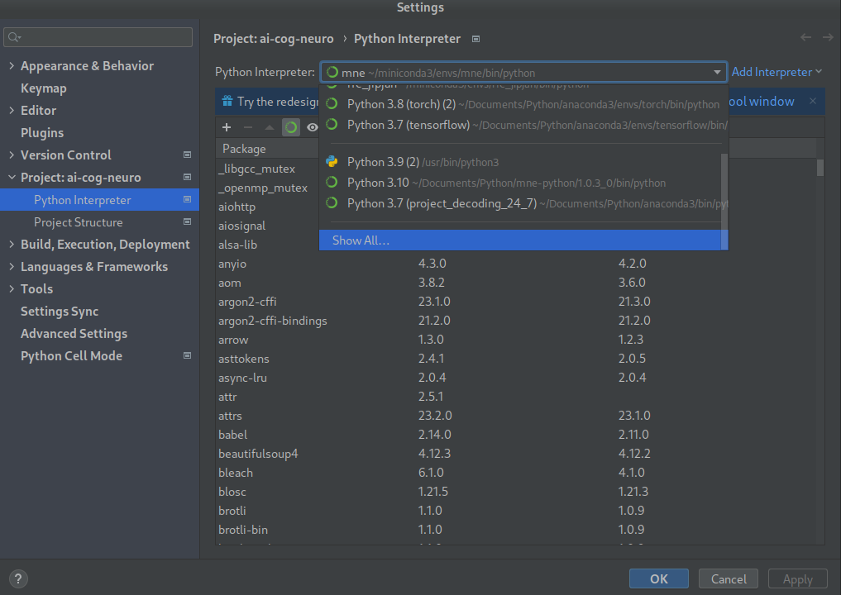
Pycharm settings

Slide 11
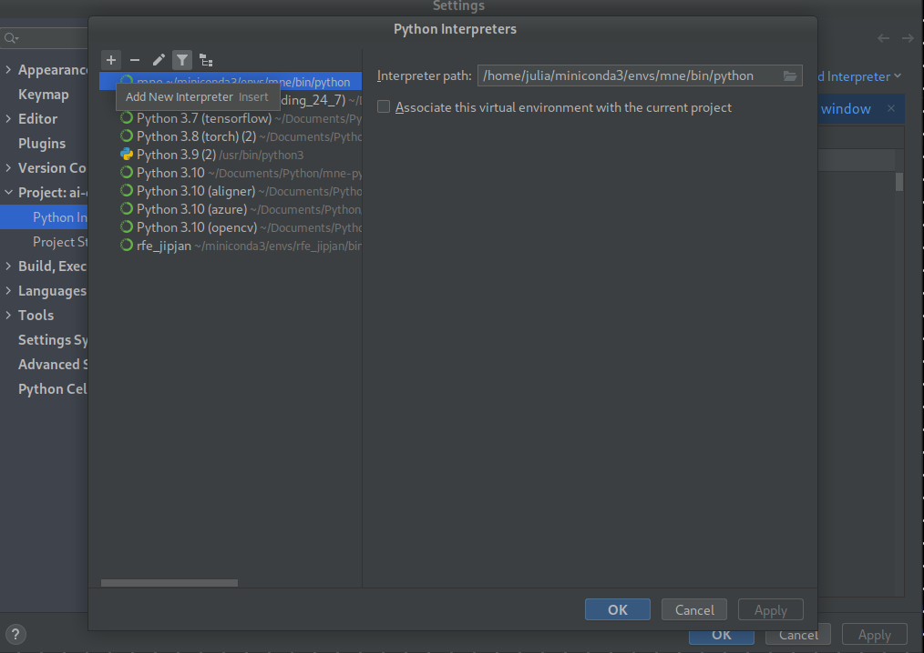

Slide 12
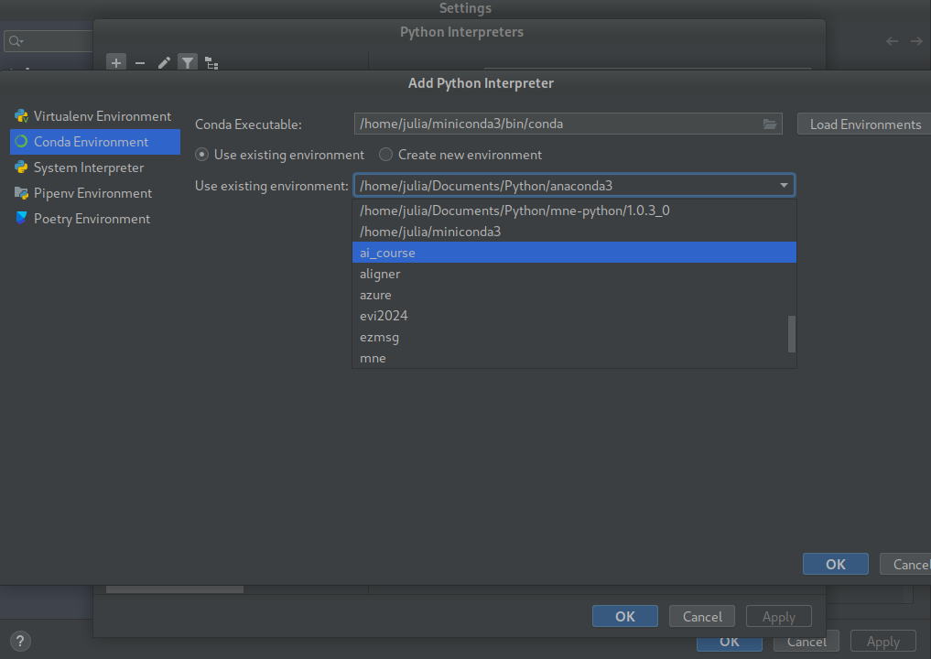

Slide 13
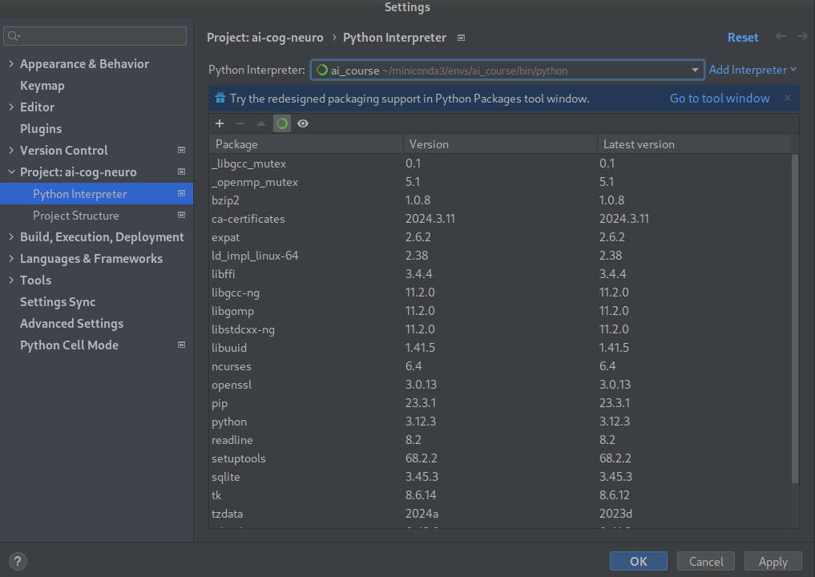

Slide 14
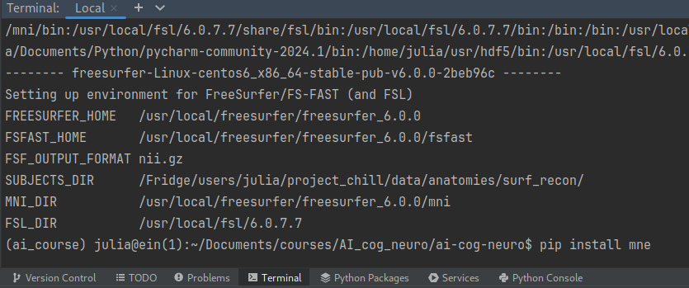
Install mne
In terminal: pip install mne

Slide 15
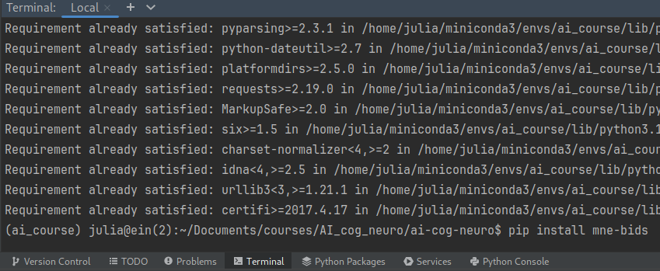
Install mne-bids
In terminal: pip install mne-bids

Slide 16
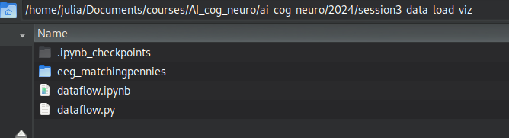
Put data next to your code
Copy the folder with data to the directory of your code

Slide 17
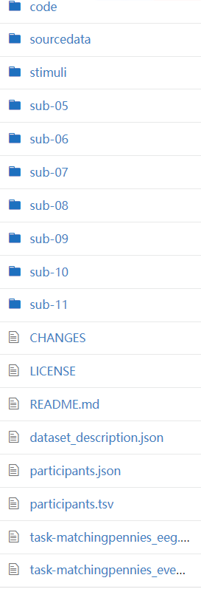
BIDS: standard for reproducible neuroscience
Folders organized by subject
Meta information in json
Tables in tsv
EEG data in BrainVision format: eeg, vmrk, vhdr

Slide 18
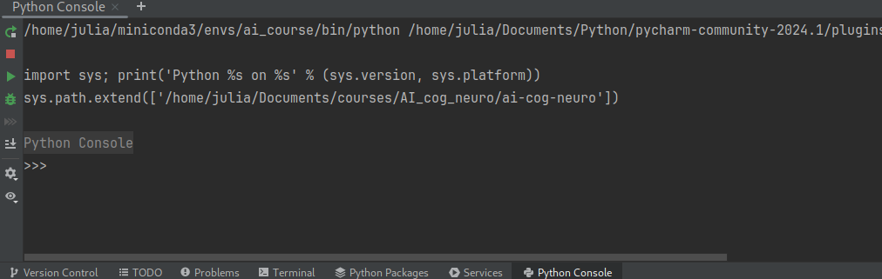
Start with the script
Switch to Python console

Slide 19
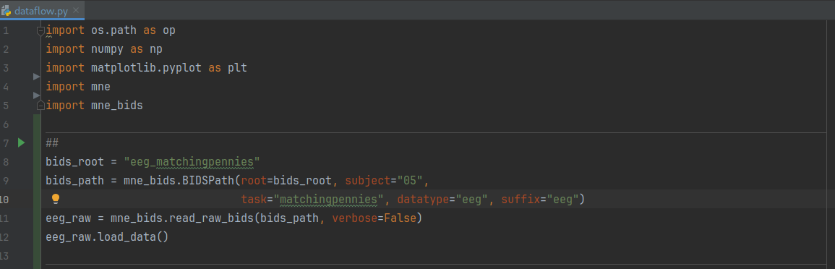
Cntr + enter to run the cell

Slide 20
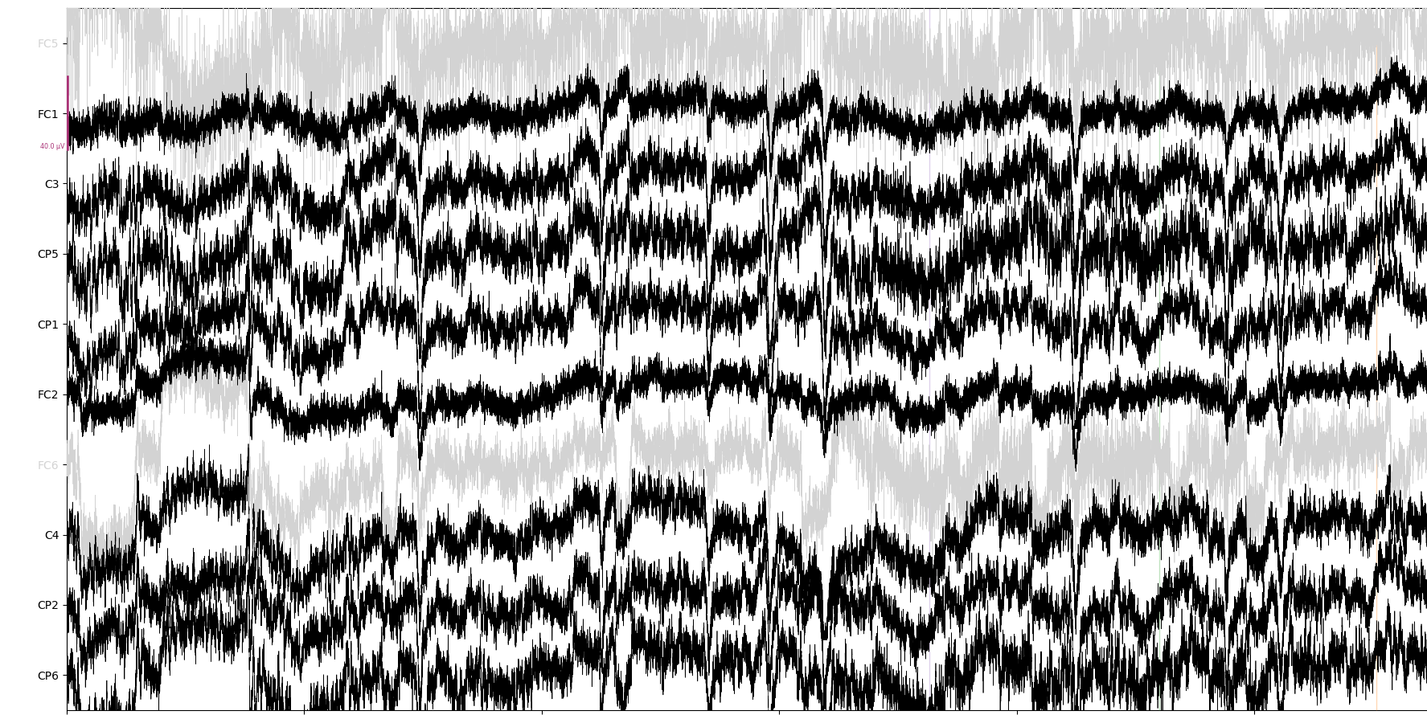
Time domain plot for EEG
eeg_raw.plot()
Exercise: can you make it plot from 10th second for 60 seconds?

Slide 21
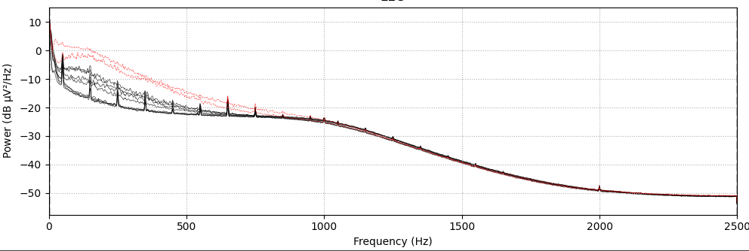
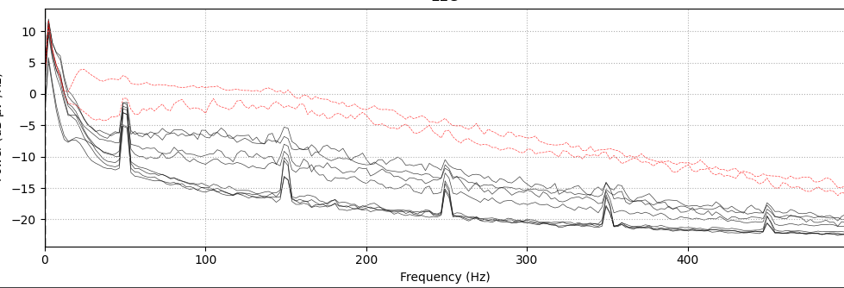
Power density plot: frequency analysis of EEG
eeg_raw.compute_psd().plot()
Exercise: can you make it plot only to a specific frequency? E.g. 500 Hz

Slide 22
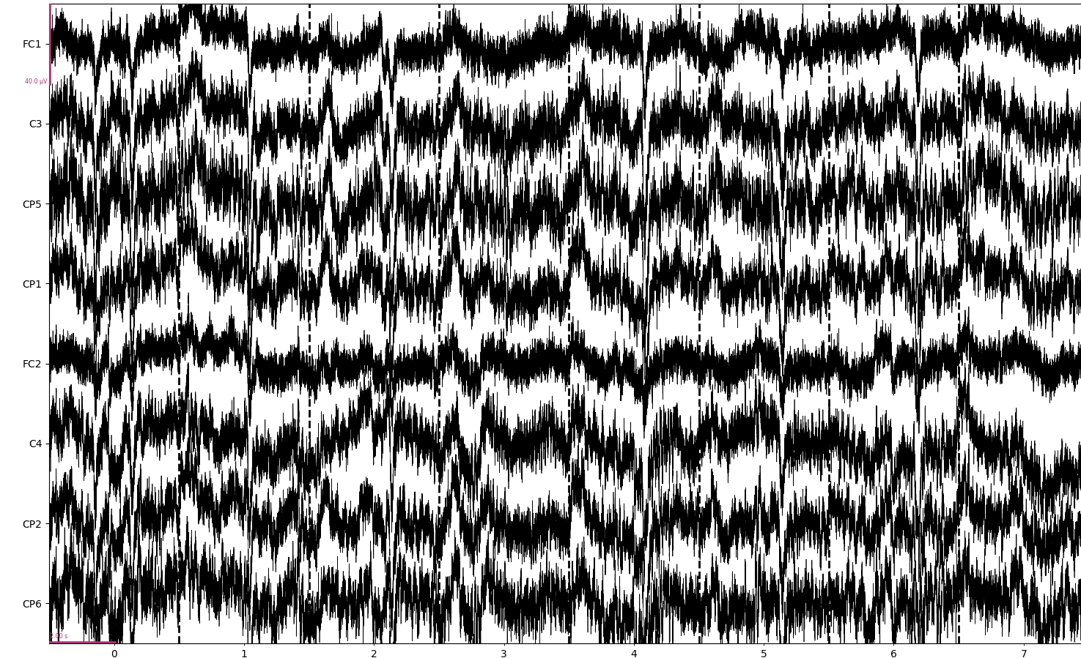
Preprocess
High-pass filter + get events
Epochs
Question: What happens to bad channels?

